Slide 1

Adult income prediction
-Technical Analysis

Slide 2
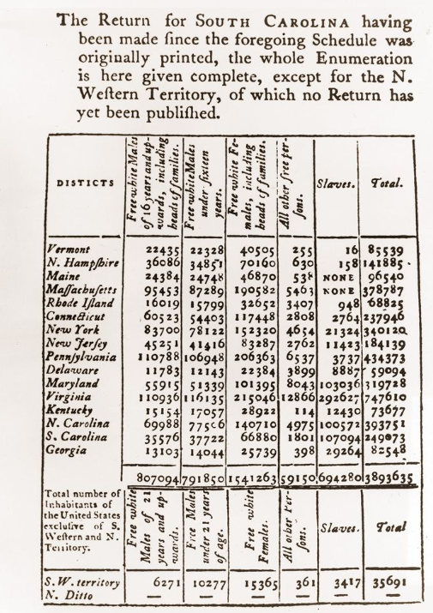
For the first Census, 650 men on horseback were dispatched to go door-to-door around the original 13 states. The overall cost in 1790 was $45,000.

Slide 3



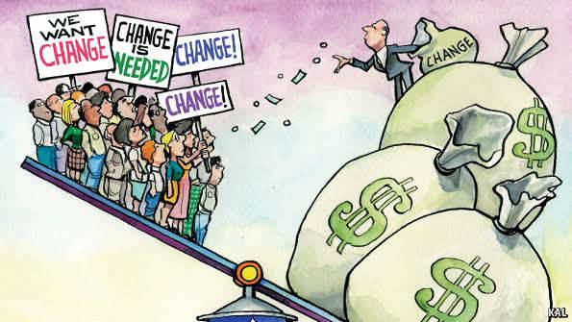
Introduction
Income inequality has long been a significant problem in the U.S., with a large percentage of wealth going to a small percentage of the population.
Income inequality has been correlated with…
Higher levels of crime
Stress
Mental illness

Slide 4


Problem Statement
This study aims to show the usage of machine learning techniques to address the income equality problem.
Classification has been done to predict whether a person’s yearly income is US falls in the income category of
Either grater than 50K Dollars
Or Less-Equal to 50K Dollars
Based on other attributes.

Slide 5

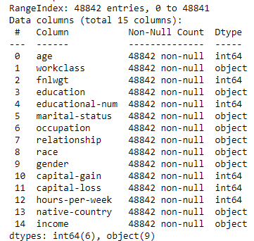
What our dataset contains
Kaggle Dataset
48,842 Records
42 Countries
14 Attributes
Income – Target column

Slide 6
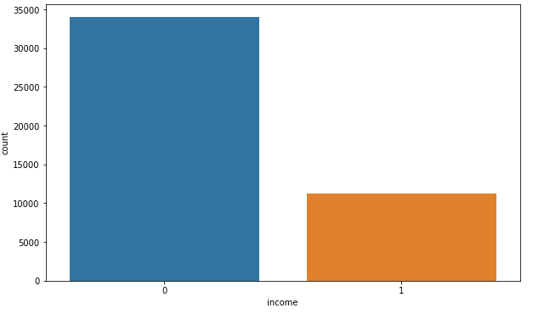
Data Assessment
45, 222 Records
34,000 people
<=50K
11,000 people
>50K
Note: Total 45,222 records left after removing NAN values in workclass, occupation and native country.

Slide 7
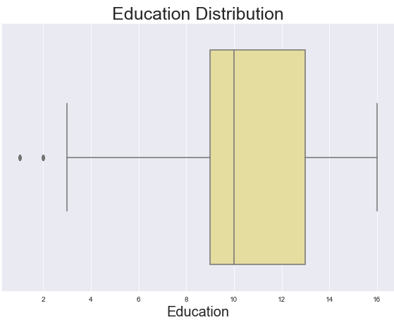
Data Assessment
50 percentile adults have completed Higher secondary to Bachelors Degree

Slide 8
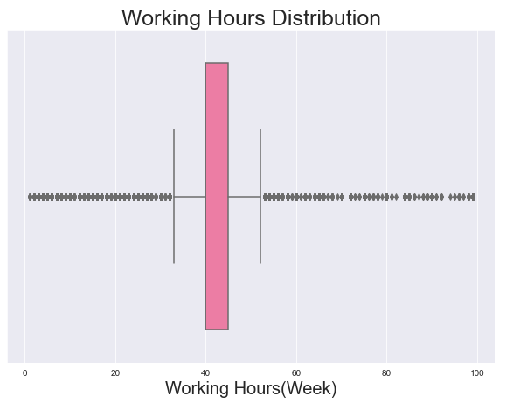
Data Assessment
50 percentile adults are working 40 to 45 hours per week.

Slide 9
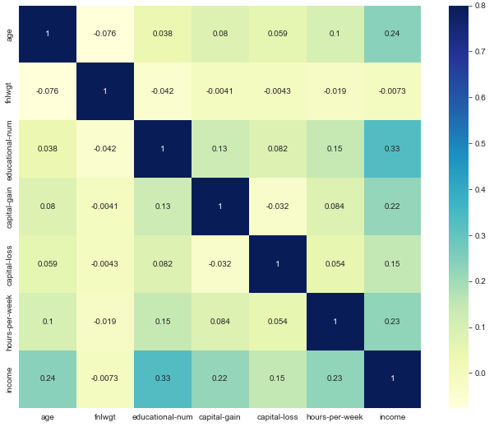
Data Assessment
The correlation matrix shows that income has high correlation with
education
Age
working hours.

Slide 10
Model Evaluation
Model | Accuracy
Logistic Regression | 84%
Decision Tree | 81%
Random Forest | 85%

Slide 11

Thank You
rutvimgohel@gmail.com

